Slide 1
BIG DATA ANALYTICS CSC – 3303 TEST: 1

Slide 2




Submitted by:
Name: Hasan Tanveer Mahmood
Matric: 1725413
BCS, Information & Communication Technology
International Islamic University Malaysia
Email : tanveer.iium@gmail.com

Slide 3
Overall Summary:
This data set contains data of different migration sector. Where stated the growth in competing job sector and the values. The dataset of Linked in shows the overview of different categories of job fields and their demands and value from different countries statistics.

Slide 4
Background:
Datasets contain the information about LinkedIn’s labor markets with detailed of their jobs skills and sector. It contains benchmark data to compare labor markets across the world.
Most of datasets have similar or different variables.

Slide 5
Data Sets:
linkedin
Skill Penetration
Industry Skills Needs
Skill Migration
Growth from Industry Transition

Slide 6
Data Science Question:
What are Relation between job sector and country?
What are the most demanding jobs in the marketplace?
What are influence of countries due to migration when it comes to income?

Slide 7
Objective:
To look at all the datasets
Finding the Correlation between the numeric column
Visualizing the datasets with relevant relations.

Slide 8
Methodology:
Data sets: The data set are given.
Tools Used:
Jupyter Notebook and Spyder (Anaconda 3).
Library Used:
pandas, numpy, matplotlib.
Using plot functions to visualize.

Slide 9
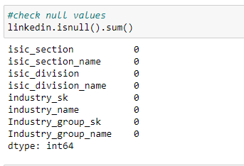
Results & Visualizations (Data set 1):
Check the null values
Here we can see that no column has the null value
So, I don’t have more work on data preprocessing.

Slide 10
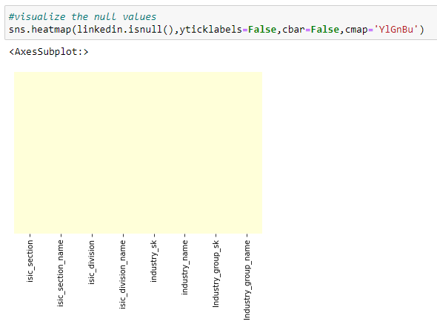
Results & Visualizations (Data set 1) (Cont.):
As here I just visualize the null value with graph view

Slide 11
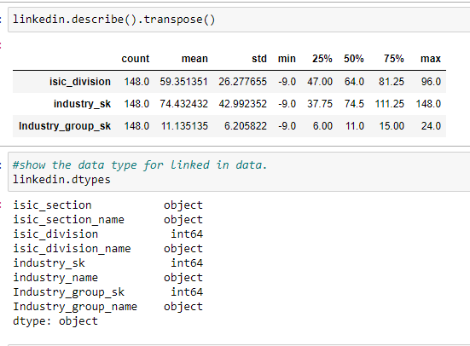
Results & Visualizations (Data set 1) (Cont.):
Here I’ve described the summary of the data where it shows the mean, standard deviation, minimum value, maximum value
And the data type of the column

Slide 12
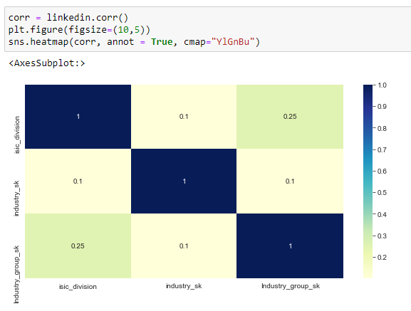
Results & Visualizations (Data set 1) (Cont.):
Here we can see the correlation.
As we can see that column are highly co-related.

Slide 13
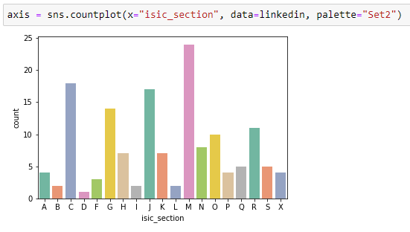
Results & Visualizations (Data set 1) (Cont.):
Here we can see the countploat of isic_section.

Slide 14
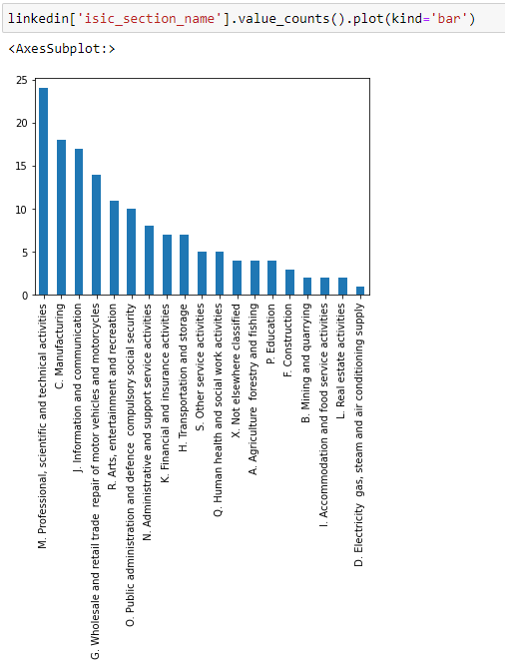
Results & Visualizations (Data set 1) (Cont.):
Here we can see the relationship between section name.
Where highest section is Technical activities and the lowest one is Conditioning supply

Slide 15
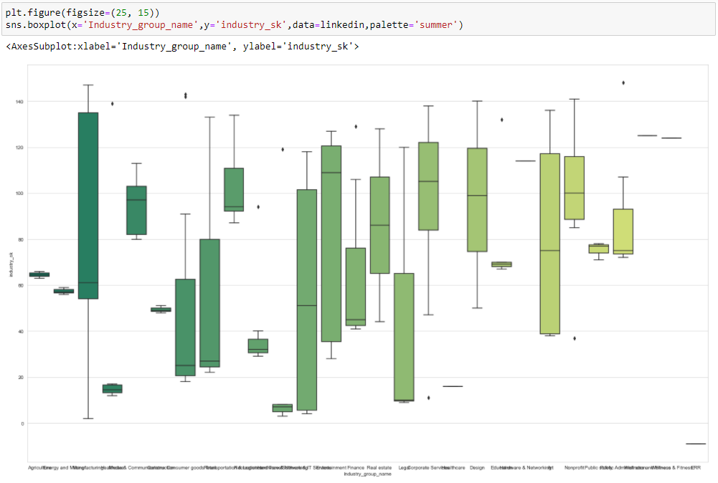
Results & Visualizations (Data set 1) (Cont.):
The box plot shows the relation between industry group and industry sk.

Slide 16
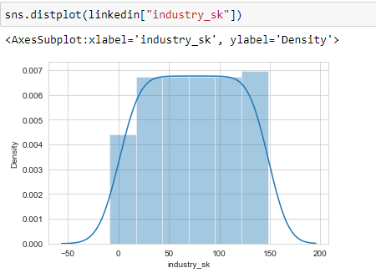
Results & Visualizations (Data set 1) (Cont.):
The distplot shows the relation between industry sk and density.

Slide 17
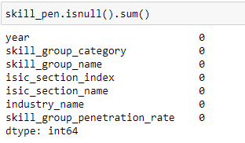
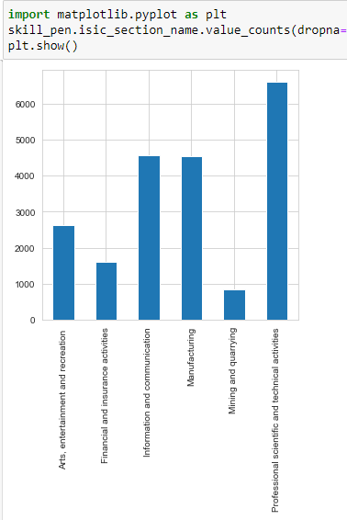
Results & Visualizations (Data set 2) (Cont.):
There are also no null values for dataset 2 which is Skill Penetration.
And the other graphs shows the sector of industry.
Where the max sector is technical Activities and min one is mining

Slide 18
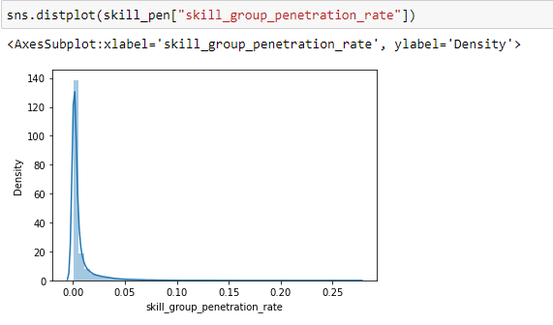
Results & Visualizations (Data set 2) (Cont.):
Here we can see the skill group penetration rate.
So, most of them are near to 0.05 and the density is highest at around 140.

Slide 19
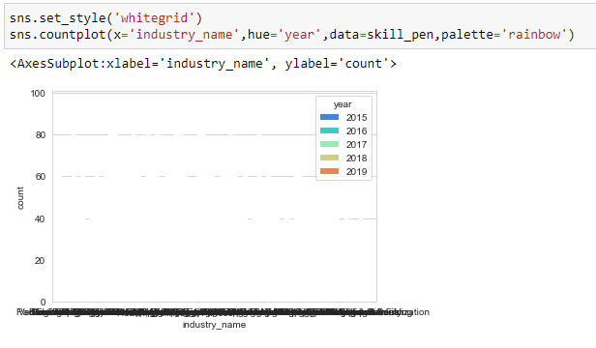
Results & Visualizations (Data set 2) (Cont.):
Here we can see the relation among country, industry name and year.

Slide 20
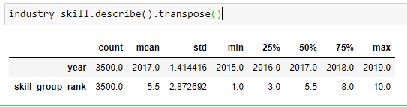
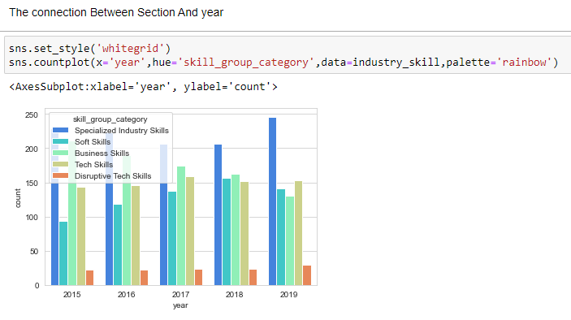
Results & Visualizations (Data set 3) (Cont.):
Here I summarized the result for dataset where shows the max, min, standard deviation.
And the graph one is showing the skill category in year and country.

Slide 21
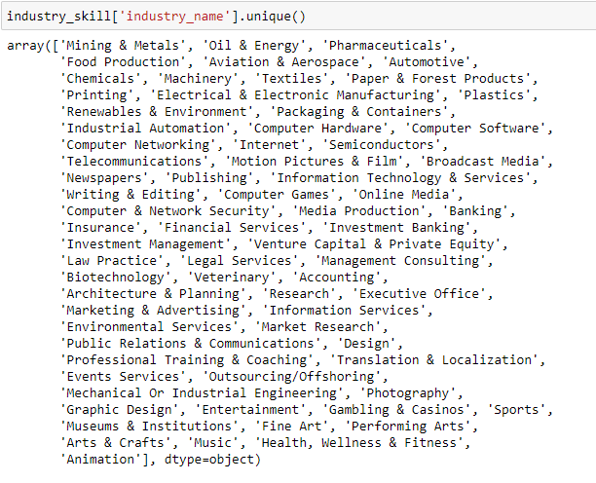
Results & Visualizations (Data set 3) (Cont.):
Here I try to find the unique industry name among the country.

Slide 22
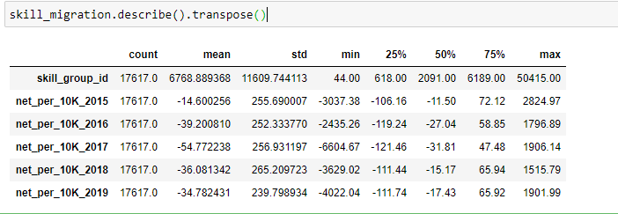
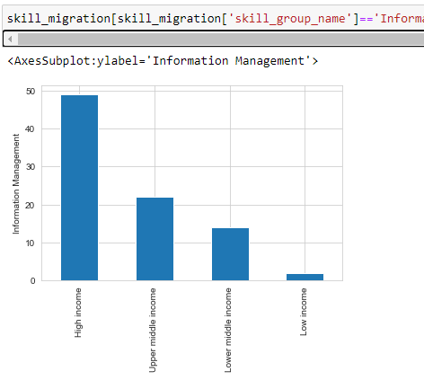
Results & Visualizations (Data set 4) (Cont.):
Here I’ve described the summary of the data where it shows the mean, standard deviation, minimum value, maximum value among the skills migration
And the bar graphs shows the income rate according to skills

Slide 23
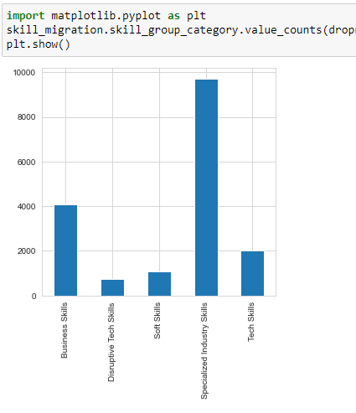
Results & Visualizations (Data set 4) (Cont.):
Here the graphs shows skills category
Where the highest category is specialized industry skills and the lowest skills is Disrupted Tech skills.

Slide 24
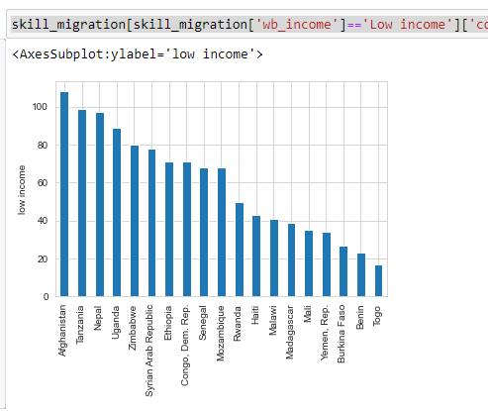
Results & Visualizations (Data set 4) (Cont.):
Here the graphs shows skills migration among the countries. Highest one is Afghanistan and the lowest one is Togo.

Slide 25
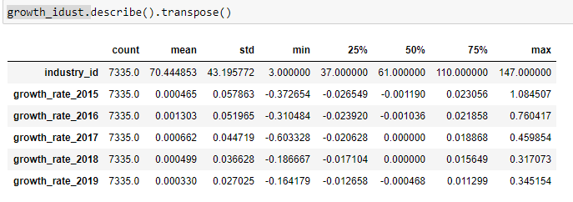
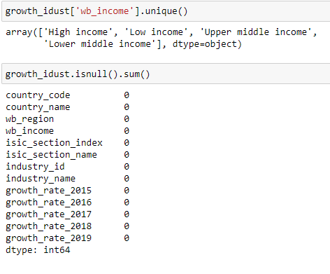
Results & Visualizations (Data set 5) (Cont.):
Here I’ve described the summary of the data where it shows the mean, standard deviation, minimum value, maximum value among the growth industry
And check the null values of growth industry.

Slide 26
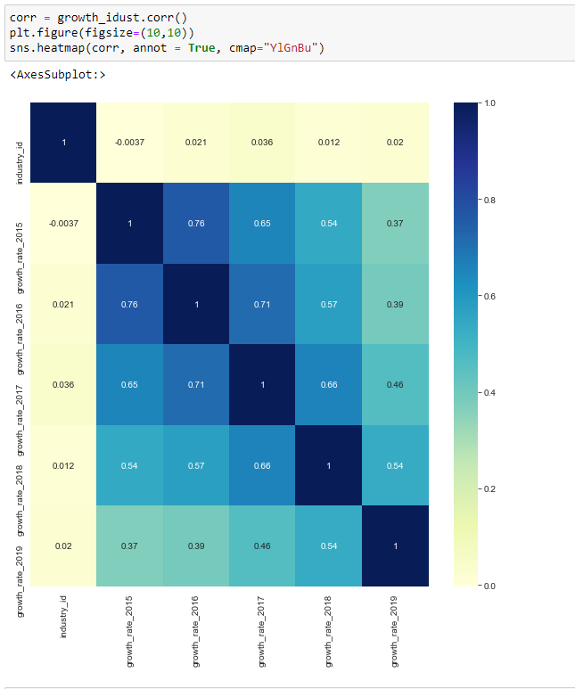
Results & Visualizations (Data set 5) (Cont.):
Here the confusion matrix shows the correlation among growth rate.

Slide 27
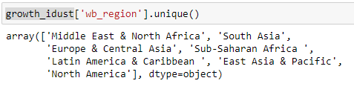
Results & Visualizations (Data set 5) (Cont.):
Here I try to find the unique region.

Slide 28
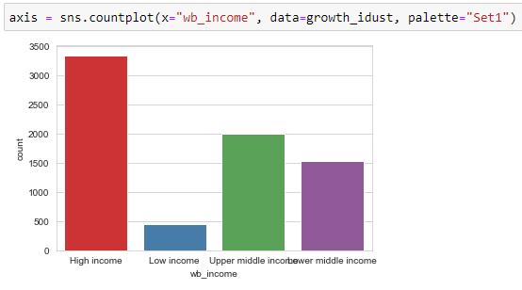
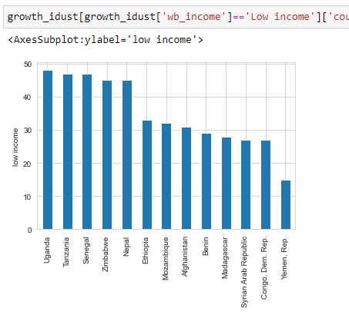
Results & Visualizations (Data set 5) (Cont.):
Here graph 1 shows the income rate.
And graphs 2 shows the low income rate among the countries.

Slide 29
References:
https://matplotlib.org/tutorials/introductory/pyplot.html
https://pynative.com/python-matplotlib-exercise/

Slide 30

Thank You.

